Slide 1
Data Science and Machine Learning
Module 5, Lesson 6:
Clustering

Slide 2
Topics
Clustering
Unsupervised Learning
K-Means

Slide 3
Objectives
By the end of this lesson you should be able to:
Understand what a clustering algorithm does
Understand supervised and unsupervised learning
Recognize the K-Means algorithm
Run K-Means on Spark MLlib

Slide 4

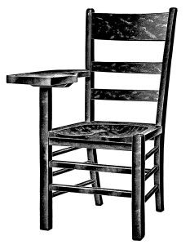


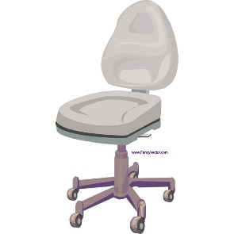



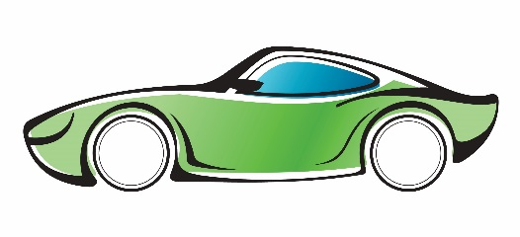

Classification – Supervised Learning
Labeled Training Set
Test Set
Chair ?
chair
Not chair
Not chair
Not chair
Not chair
chair
Notes:
Notes:
In classification, we saw that we had a dataset labeled with ground truth observations. This was supervised learning.

Slide 5
Clustering – Unsupervised Learning
What are these items?
Notes:
Notes:
This represents unsupervised learning.

Slide 6
Goal is to Group Items into Clusters

Slide 7
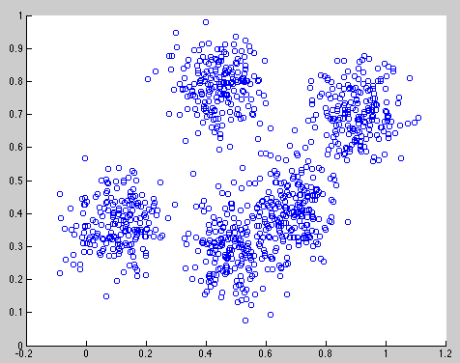
Clustering
Data within clusters should be similar to each other member of the cluster
Notes:
Notes:
This slide has an animation, shows clusters.
References:
https://courses.edx.org/courses/course-v1:Microsoft+DAT203x+3T2015/info

Slide 8
What Does Clustering Do?
Groups items based on similar characteristics
Grouping customers with similar purchase behaviors
Automatically grouping documents, web pages, or other text
Grouping news items based on topic
Derives plant and animal taxonomies
Categorizes genes with similar functionalities
Notes:
References:
https://courses.edx.org/courses/course-v1:Microsoft+DAT203x+3T2015/info

Slide 9
K-Means Clustering
Group items based cluster centers
Input the number of clusters (K) and randomly initialize the centers.
Assign every point in the data to closest one of these centers.
For each of the cluster centers, move the center to the middle of that cluster (mean).
Reassign each point to the new closest center.
Repeat from step 2 until convergence.
Notes:
Notes:
The algorithm is quite simple and best illustrated with an example
In each iteration, a new mean (average distance to centers for each point) is calculated meaning, move the center to the middle
Once new centers have been assigned, for each point, find the center with the shortest distance and assign to that cluster
Repeat until converged
References:
https://courses.edx.org/courses/course-v1:Microsoft+DAT203x+3T2015/info

Slide 10
K-Means – Initial Centers
Input number of clusters K
Assign K centers randomly
Notes:
References:
https://courses.edx.org/courses/course-v1:Microsoft+DAT203x+3T2015/info

Slide 11
K-Means – Assign Centers
Assign all points to the closest center
Notes:
References:
https://courses.edx.org/courses/course-v1:Microsoft+DAT203x+3T2015/info

Slide 12
K-Means – Move Center to Middle
Change cluster centers to be in the middle of its points
Notes:
References:
https://courses.edx.org/courses/course-v1:Microsoft+DAT203x+3T2015/info

Slide 13
K-Means – Initial Centers
Repeat until convergence
Notes:
References:
https://courses.edx.org/courses/course-v1:Microsoft+DAT203x+3T2015/info

Slide 14
Spark - KMeans
Group items based on similar characteristics
Train method key parameters
Rdd -> dataset name
k -> number of clusters
initializationMode -> how to initialize centers
Notes:
References:
http://spark.apache.org/docs/latest/api/python/pyspark.mllib.html#pyspark.mllib.clustering.KMeans

Slide 15
Sample K-Means Clustering on pySpark
from pyspark.mllib.clustering import KMeans, KMeansModel
from numpy import array
from math import sqrt
# Load and parse the data
data = sc.textFile("data/mllib/kmeans_data.txt")
parsedData = data.map(lambda line: array([float(x) for x in line.split(' ')]))
# Build the model (cluster the data)
clusters = KMeans.train(parsedData, 2, maxIterations=10,
runs=10, initializationMode="random")
# Evaluate clustering by computing Within Set Sum of Squared Errors
def error(point):
center = clusters.centers[clusters.predict(point)]
return sqrt(sum([x**2 for x in (point - center)]))
WSSSE = parsedData.map(lambda point: error(point)).reduce(lambda x, y: x + y)
print("Within Set Sum of Squared Error = " + str(WSSSE))
# Save and load model
clusters.save(sc, "myModelPath")
sameModel = KMeansModel.load(sc, "myModelPath")
Notes:
Notes:
Run through the code
References:
http://spark.apache.org/docs/latest/mllib-clustering.html#k-means

Slide 16
Import Necessary Libraries
from pyspark.mllib.clustering import KMeans, KMeansModel
from numpy import array
from math import sqrt
Notes:
Notes:
The main import is Kmeans and KMeansModel
References:
http://spark.apache.org/docs/latest/mllib-clustering.html#k-means

Slide 17
Build the K-means Model
# Load and parse the data
data = sc.textFile("data/mllib/kmeans_data.txt")
parsedData = data.map(lambda line: array([float(x) for x in line.split(' ')]))
# Build the model (cluster the data)
clusters = KMeans.train(parsedData, 2, maxIterations=10,
runs=10, initializationMode="random")
Notes:
Notes:
Load the text dataset into the SparkContext sc.
Parse each line of data. Each datapoint is separated by a space. Save all the data points into an array of floats.
Run the actual Kmeans.train program. Pretty simple!!
parsedData is the dataset RDD
2 is k, or number of clusters to look for
maxIteration is the maximum number of iterations for convergence
runs is the number of runs of the algorithm to execute in parallel
initializationMode. This can be random or k-means|| (k-means|| is default)
Random -> random initialization of clusters
K-means|| -> a parallel variant of k-means++ (Bahmani et al., Scalable K-Means++)
Explanation of the optimization is beyond scope of lesson
References:
http://vldb.org/pvldb/vol5/p622_bahmanbahmani_vldb2012.pdf
http://spark.apache.org/docs/latest/mllib-clustering.html#k-means

Slide 18
Evaluate
# Evaluate clustering by computing Within Set Sum of Squared Errors
def error(point):
center = clusters.centers[clusters.predict(point)]
return sqrt(sum([x**2 for x in (point - center)]))
WSSSE = parsedData.map(lambda point: error(point)).reduce(lambda x, y: x + y)
print("Within Set Sum of Squared Error = " + str(WSSSE))
# Save and load model
clusters.save(sc, "myModelPath")
sameModel = KMeansModel.load(sc, "myModelPath")
Notes:
Notes:
Recall parsedData is an RDD
References:
http://spark.apache.org/docs/latest/mllib-clustering.html#k-means

Slide 19
Summary
In this lesson, you have learned how to:
Understand what a clustering algorithm does
Understand supervised and unsupervised learning
Recognize the K-Means algorithm
Run K-Means on Spark MLlib

